Slide 1
Technocracy (1997-2013)
Jack Szymanski, Alex Lee

Slide 2
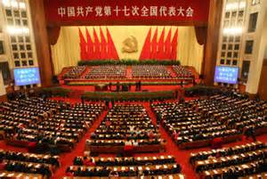
Regime
Five year terms
Authoritarian/coercive
Unitary
One party system (communist party)
High autonomy
Low Accountability

Slide 3
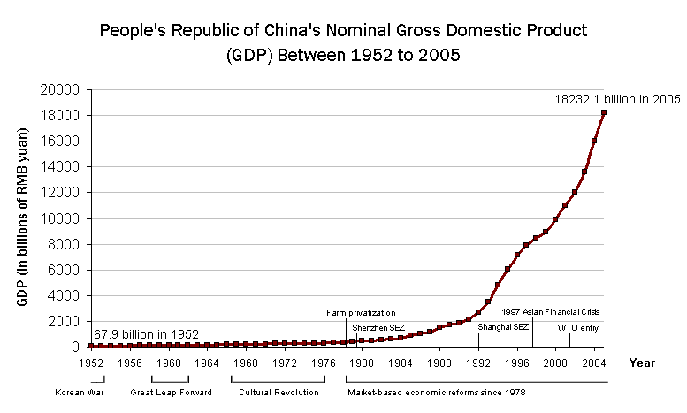
Economy
Mixed economy (more privatization)
Industrial
Rentier state

Slide 4
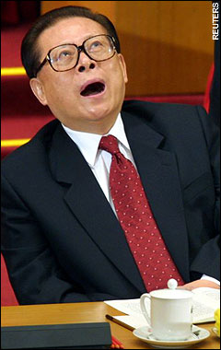
Leader: Jiang Zemin
Engineer
Communist
Authoritarian
Coercive
Liberal
Ideological
Traditional and Legal-Rational Legitimacy

Slide 5
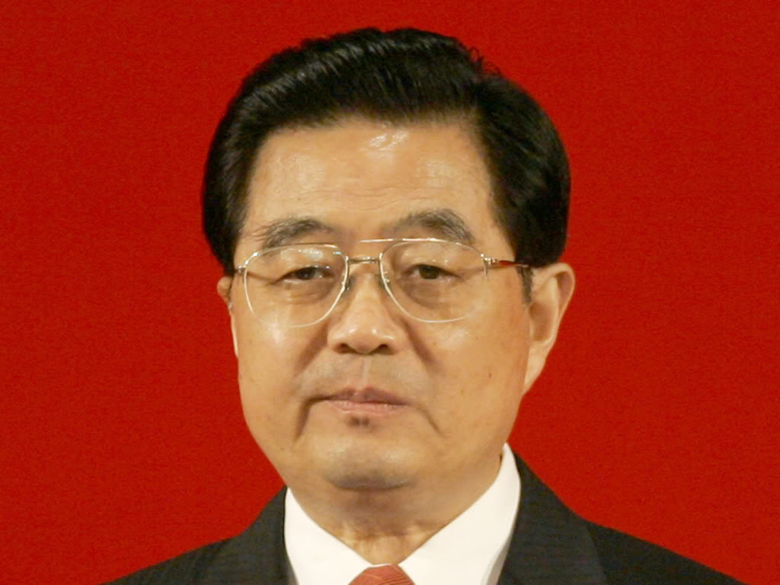
Leader: Hu Jintao
Engineer
Communist
Authoritarian
Coercive
Conservative
Pragmatic
Traditional and Legal-Rational Legitimacy

Slide 6
Ideology
Three Represents:
Economic Development
Cultural Richness
Political Consensus
Non-Ideological Pragmatism
Social Stability→ Economic Development
Morality: “Eight Honors and Eight Shames”

