Slide 1
Qing Dynasty
Alex and Jack

Slide 2
Regime
Mandate of Heaven
Absolute monarchy
Traditional legitimacy

Slide 3
Economy
Command & restricted

Slide 4
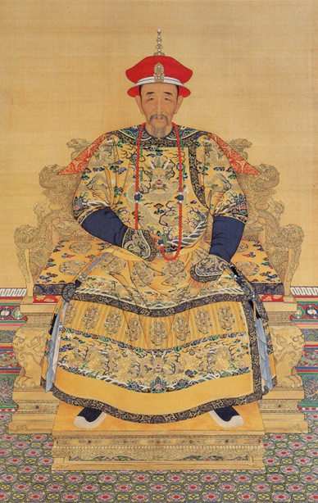
Emperor Kangxi (1661-1772)
Unification of China
Suppression of rebellion
Creation of Dictionary

Slide 5
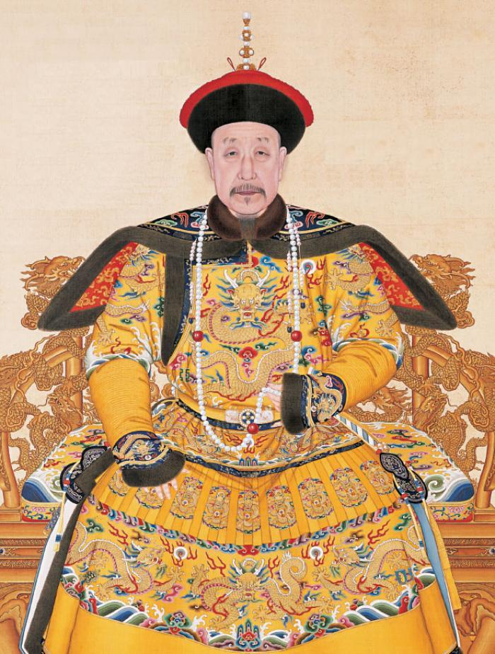
Emperor Qianlong (1735- 1796)
Prosperity
Suppression of Rebellion

Slide 6
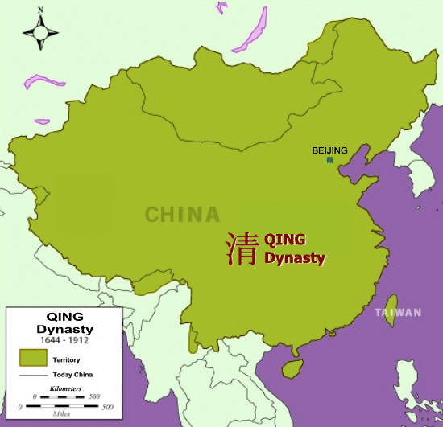
Ideology (foreign)
Expansion in Asia
Isolationism from the West

Slide 7
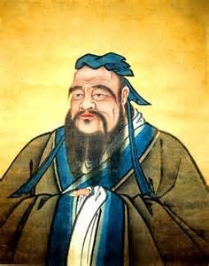
Ideology (domestic)
Confucianism

Slide 8
Bibliography
http://www.chinaknowledge.de/History/Qing/qing-event.html
http://www.travelchinaguide.com/intro/history/qing.htm
http://history.cultural-china.com/en/183History8427.html
http://www.chinaknowledge.de/History/Qing/qing-religion.html
http://www.chinahighlights.com/travelguide/china-history/emperor-kangxi.htm
http://www.chinahighlights.com/travelguide/china-history/the-qing-dynasty.htm

