Slide 1
President Xi (2013-present)
Jack Szymanski, Alex Lee

Slide 2
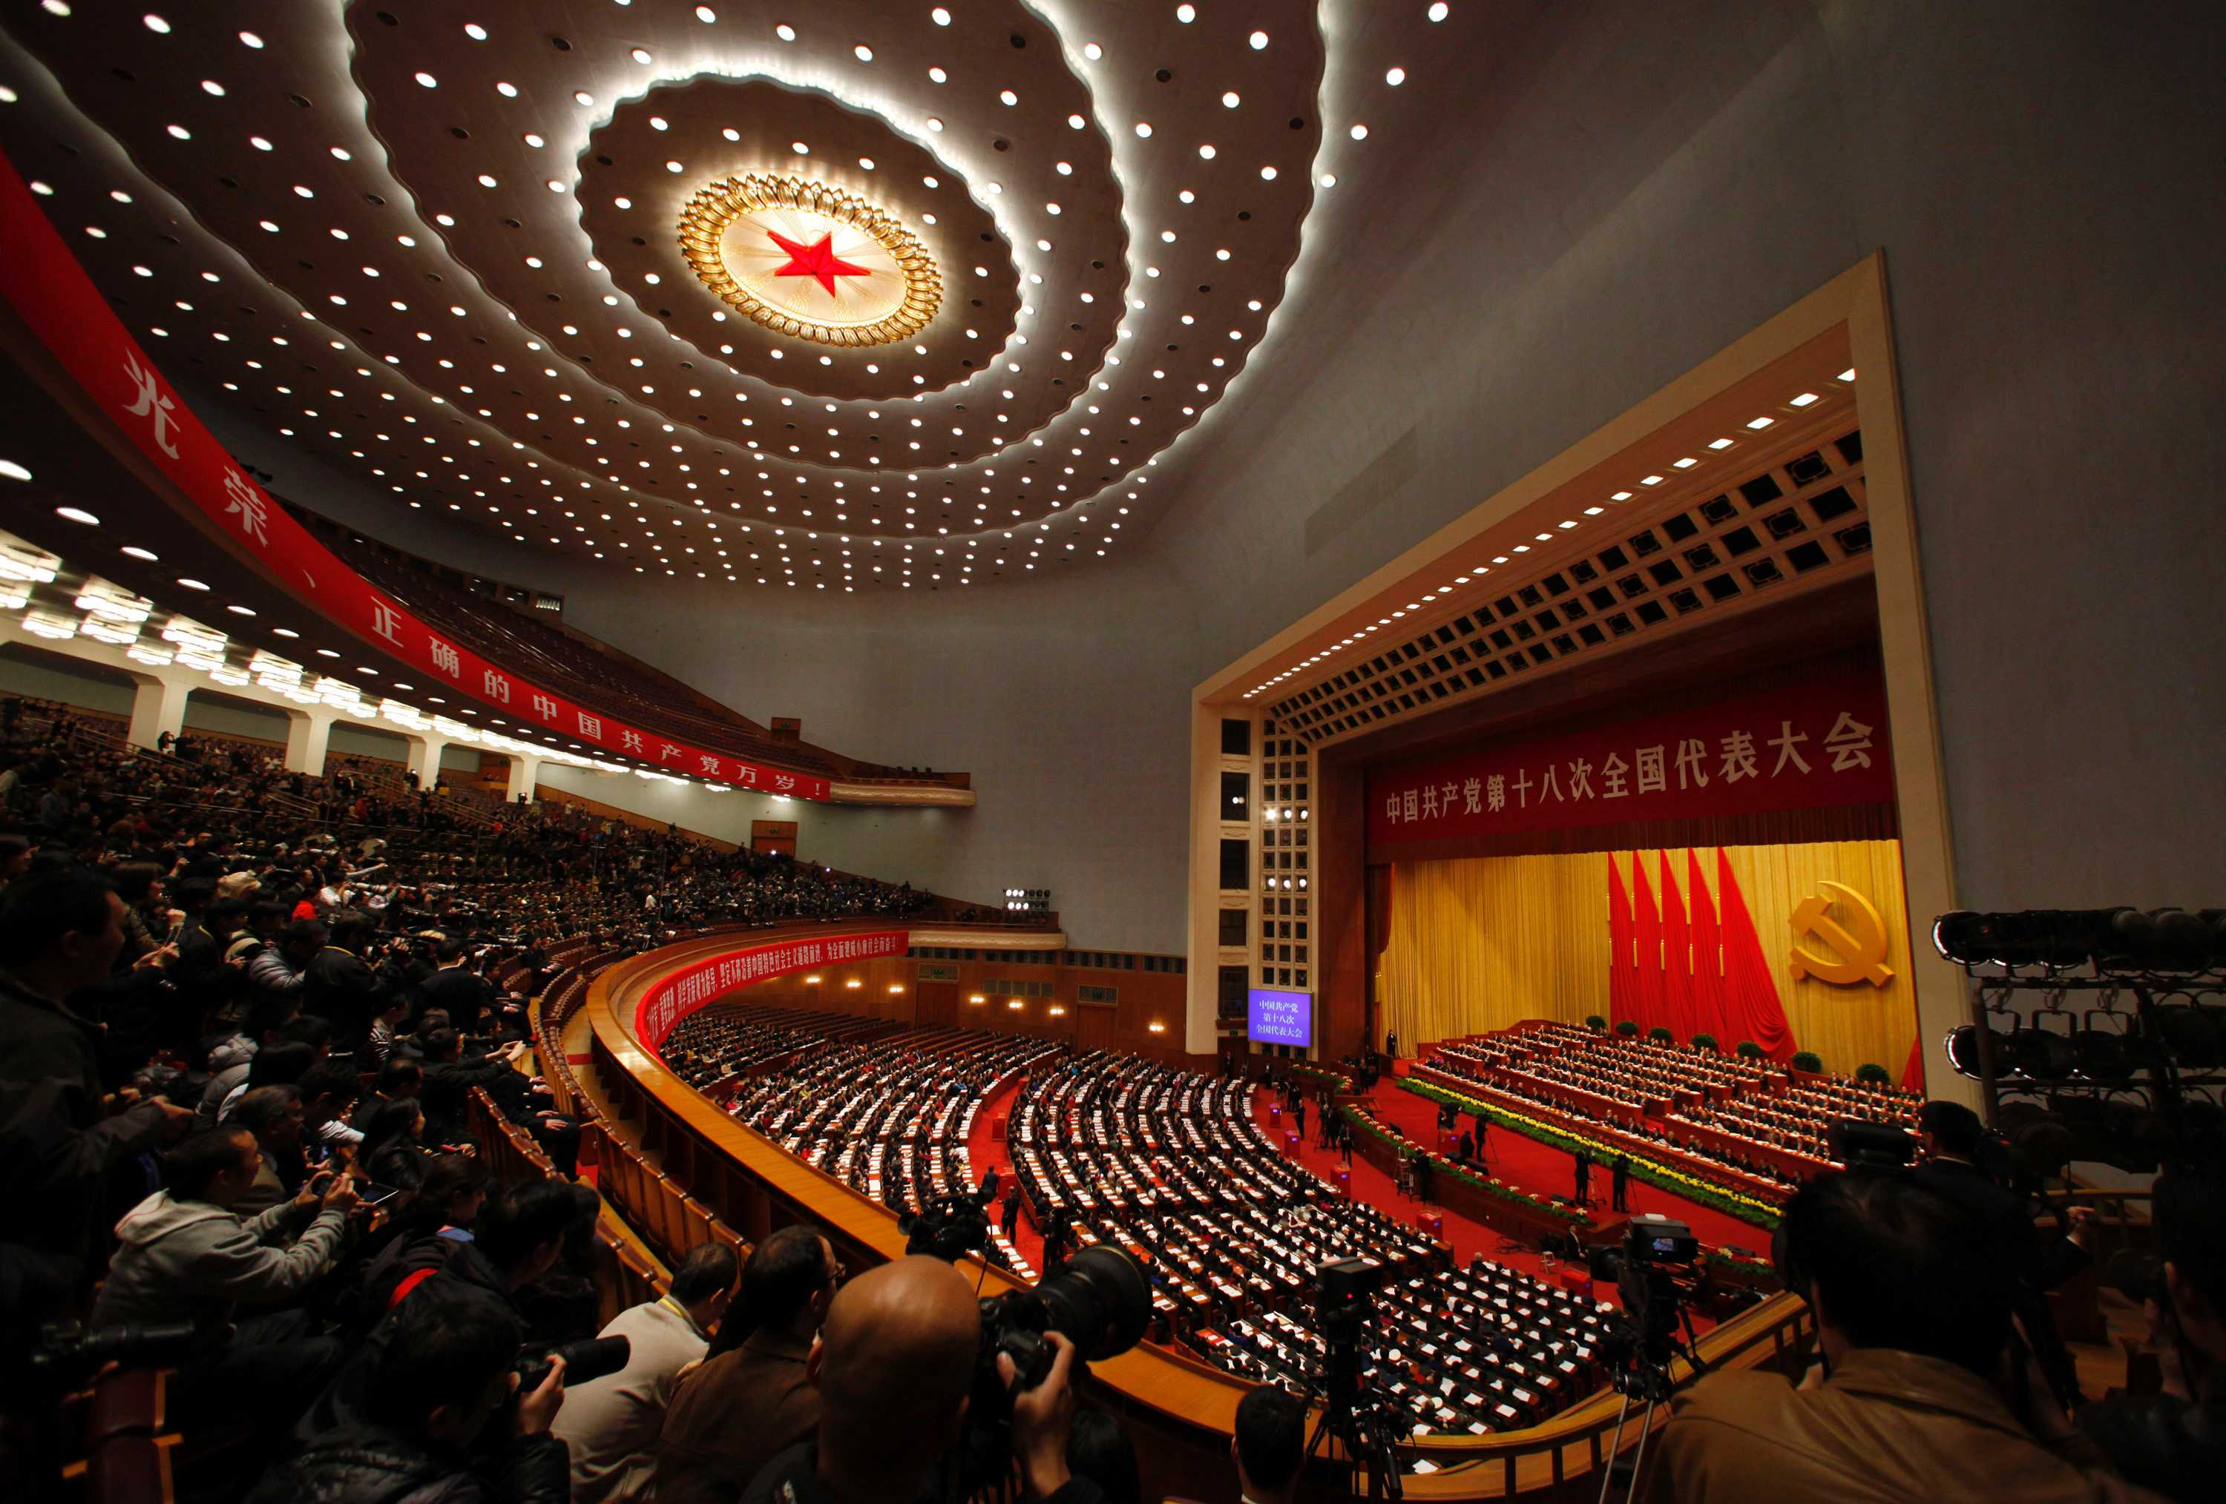
Regime
Authoritarian
Unitary
Communism
Coercive
High autonomy
Some accountability

Slide 3
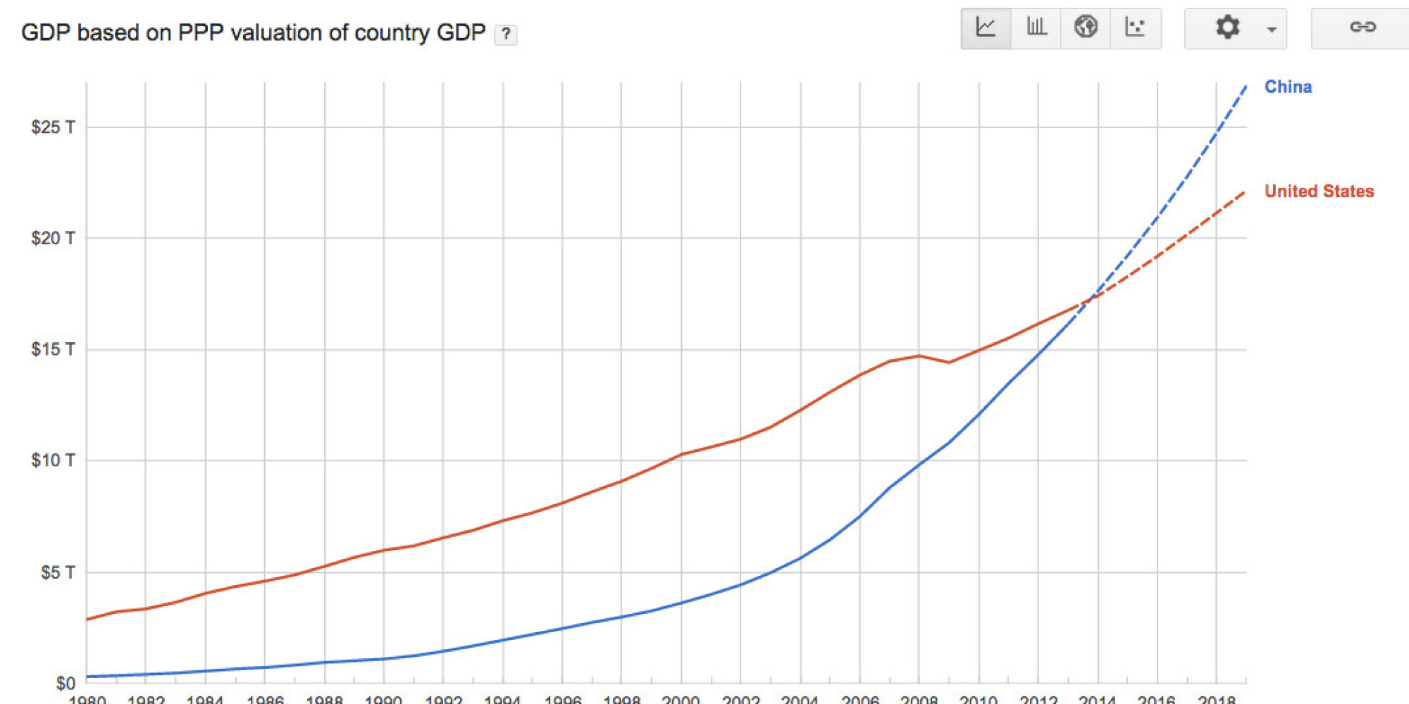
Economy
Mixed economy
Industrial

Slide 4
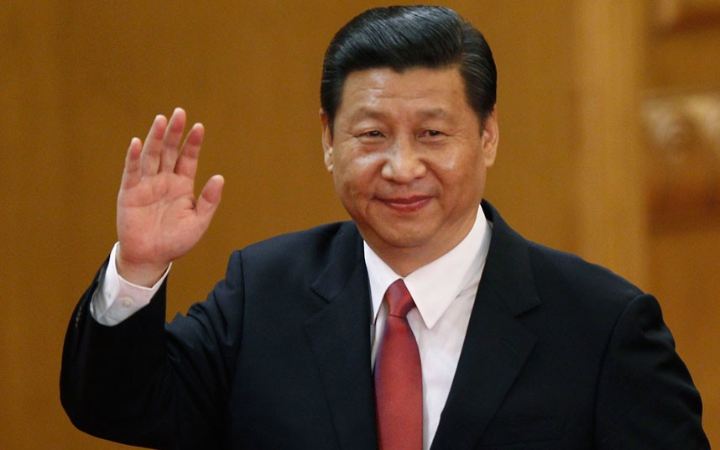
Leader: Xi Jingping
Technocrat→ Chemical Engineer
Authoritarian
Coercive
Conservative (Liberal Appearance)
Reformer→ Anti-Corruption
3 Legitamcies

Slide 5
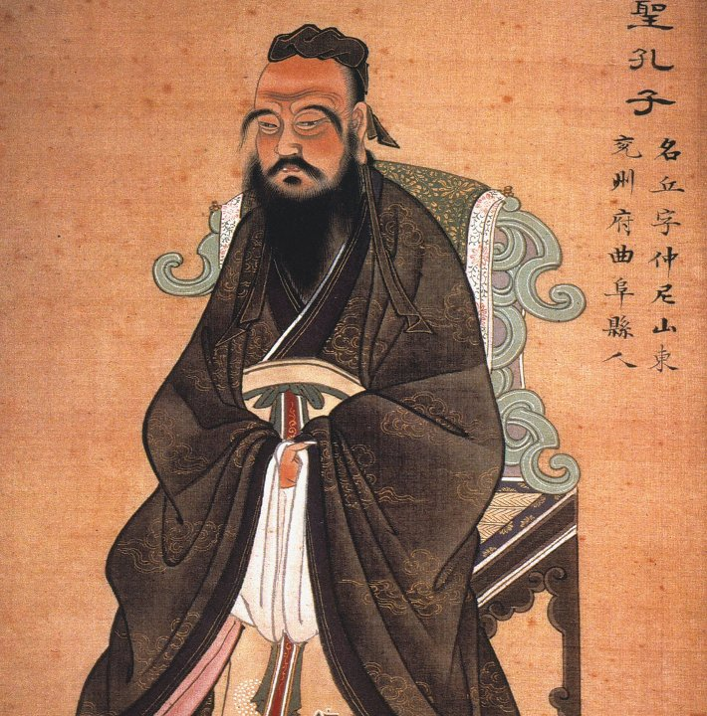
ideology
“The Chinese Dream”
CCP Traditional Ideology as an enforver
Counter-Revolution

Slide 6
Quote
"The ideology and culture of today's China, is a continuation and sublimation of traditional Chinese ideology and culture. To understand present-day China, to know the present-day Chinese, one must delve into the cultural bloodline of China, and accurately appreciate the cultural soil that nourishes the Chinese people. Confucianism, is key to understanding the national characteristics of the Chinese as well as the historical roots of the spiritual world of the present-day Chinese. Confucianism has morphed with the times, and evolved in accordance with corresponding conditions, constantly refreshing itself while responding to demands of the times. This is why it has had such lasting vitality."

Slide 7
bibliography
http://www.huffingtonpost.com/nathan-gardels/xi-jinping-confucianism_b_5897680.html
http://www.economist.com/news/leaders/21577070-vision-chinas-new-president-should-serve-his-people-not-nationalist-state-xi-jinping
http://thediplomat.com/2014/03/is-xi-jinping-a-reformer/
The textbook

