Slide 1
New Labour
Jeanie Shin
Jiny Kim

Slide 2
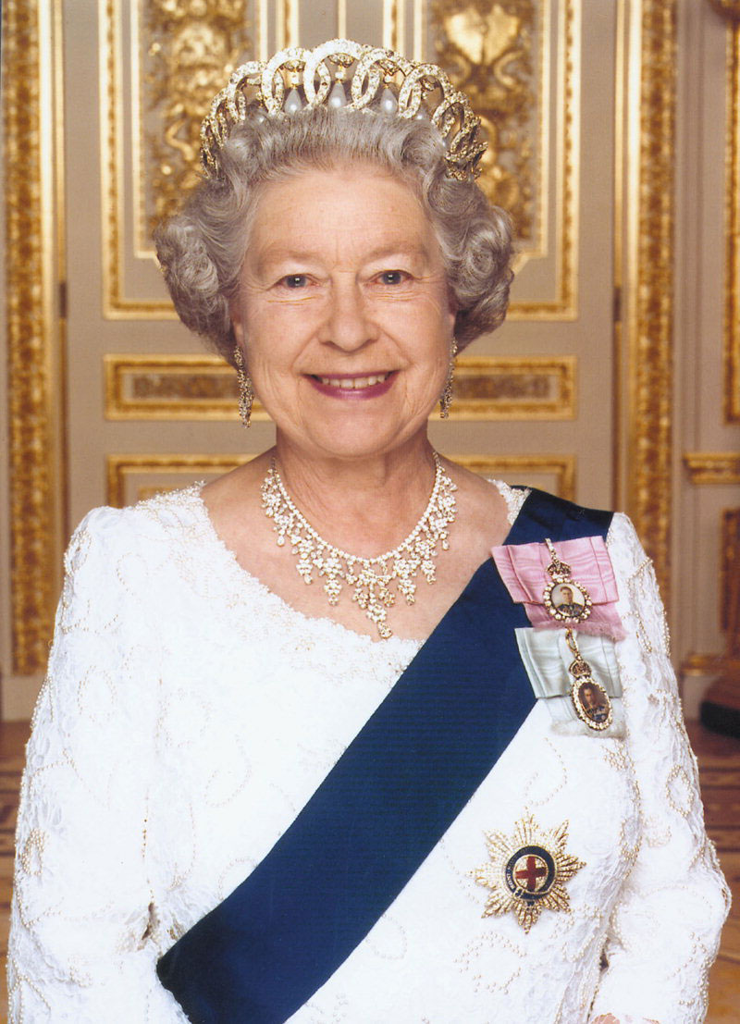
Regime
Constitutional Monarchy
Elizabeth II
Unitary
Accountable/ Transparent
Consensus rather than coercion

Slide 3
Economy
No severe economic depression
Unbroken GDP growth
Financial Crisis

Slide 4
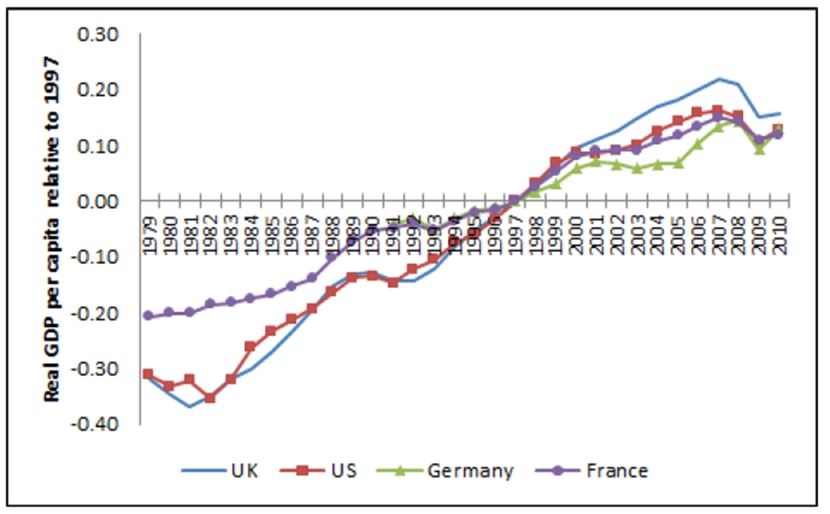

Slide 5
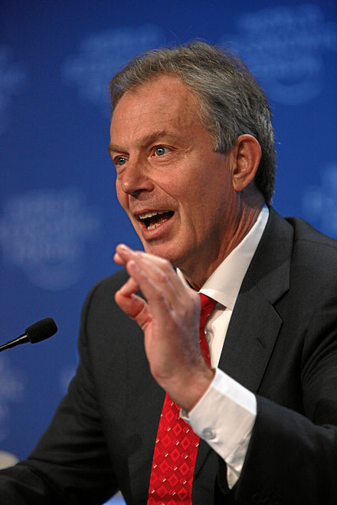
Tony Blair
Prime Minister 1997-2007
Labour Party Politician
Used the phrase “New Labour” to distance it from previous labour policies

Slide 6
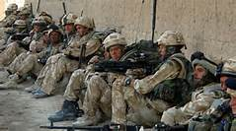
Ideology
Modernization
“Special Relationship”
Afghanistan War
Complication of relationships

Slide 7
How did it change?
Labour Party became the leading party
National minimum wage
Devolution of power
Increased spending on hospitals and medical staff

Slide 8
Bibliography
http://www.bbc.com/news/uk-politics-10518842
Textbook

