Slide 1
Deng Xiaoping (1981-1987)
Jack Szymanski, Alex Lee

Slide 2
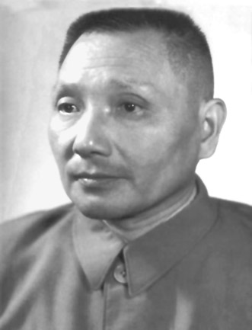
Regime
Communism
Totalitarian→ authoritarian
Coercive
Unitary
High autonomy
Low accountability

Slide 3
Economy
Command→ Regulated
Industrial

Slide 4
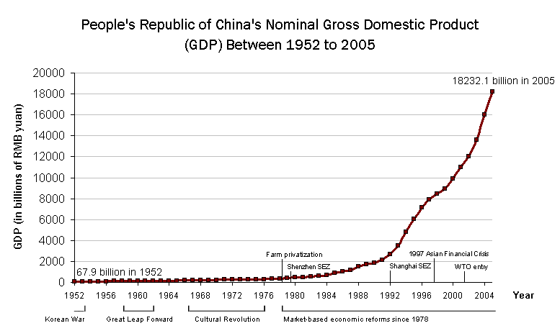

Slide 5
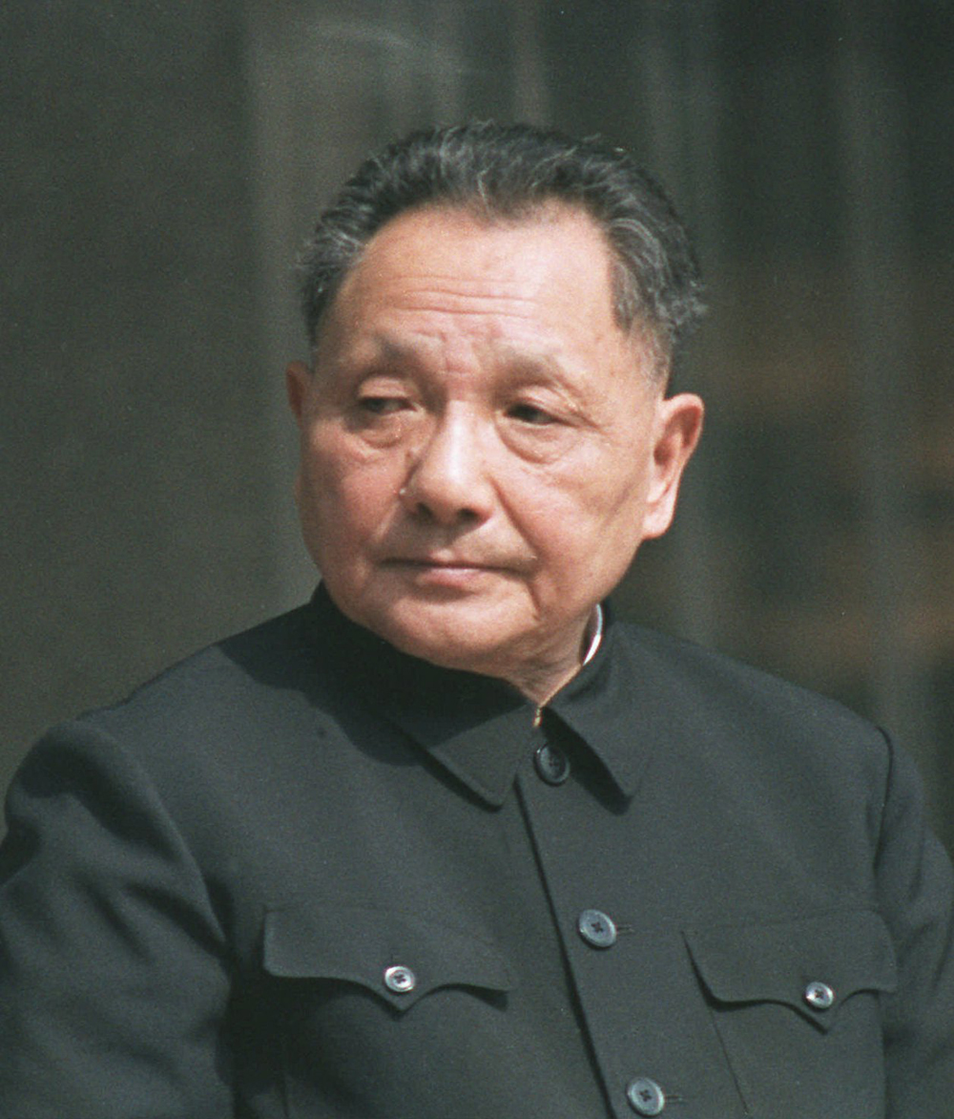
Leader: Deng Xiaoping
Authoritarian
Communist
Nationalistic
Pragmatic
Liberal: Heavy Economic Change
Charismatic & Traditional Legitimacy

Slide 6
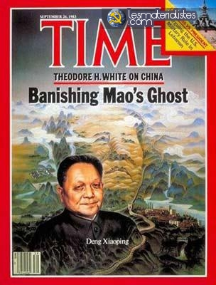
Ideology
Dengism
Pragmatic Communism
Socialist Ideas
Modern CCP

Slide 7
Bibliography
http://www.eastasiaforum.org/2011/09/27/china-under-deng-xiaopings-leadership/
http://en.wikipedia.org/wiki/Ideology_of_the_Communist_Party_of_China
http://www.britannica.com/EBchecked/topic/157645/Deng-Xiaoping
http://www.biography.com/people/deng-xiaoping-9271644
http://www.academia.edu/165448/Political_Legitimacy_and_China_s_Transition

