Slide 1
Colonial Rule and its Impact
YU JIN YANG
CINDY LEE

Slide 2
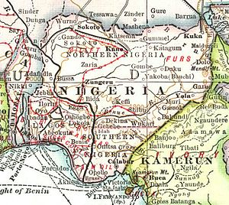
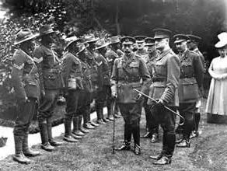
REGIME
An authoritarian political culture with formal democratic institutions

Slide 3
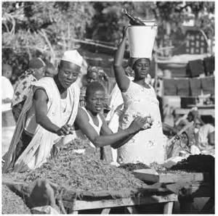
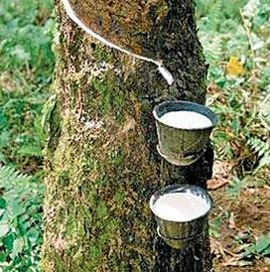
ECONOMY
Nigerian economy mainly consisted of European imperial powers extracting Nigeria’s natural resources and exploiting Nigerian labour

Slide 4
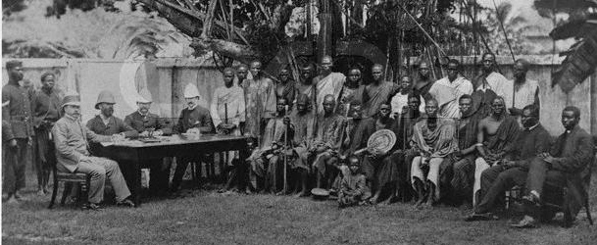
LEADER
British indirect rule
British-approved traditional chiefs and kings
Warrant chiefs

Slide 5
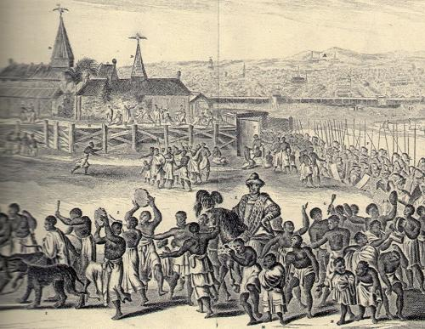
POLITICS & IDEOLOGY
The British took advantage of social and ethnic divisions to prevent the development of organized political resistance against colonial rule
British promoted democratic political systems
Colonial rule fostered political competition amongst ethnic groups
Mainly amongst Hausa-Fulani, Yoruba, and Igbo

Slide 6
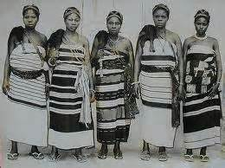
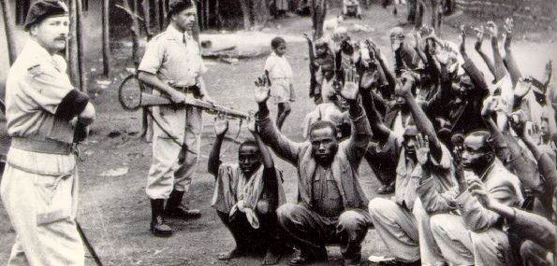
CHANGE
Weakened previous practices of accountability and participation
Strengthened various ethnic groups’ collective identities

