Slide 1
The Porfiriato
Jessica Tzeng

Slide 2
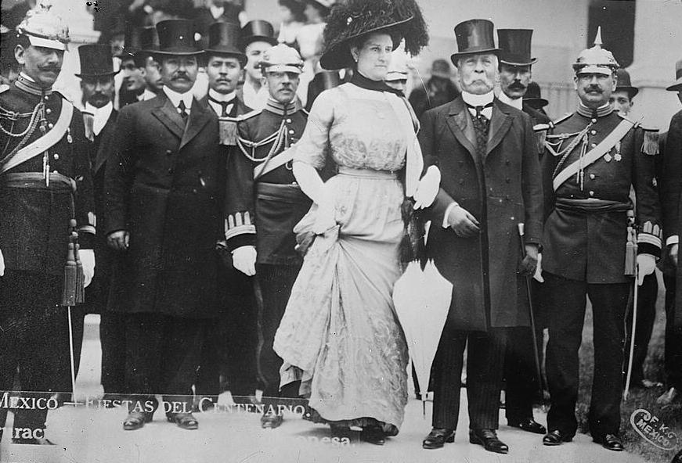
Regime
No Re-election (Revolution of Tuxtepec)
Strong centralized government→ Authoritarian
Basically a 35 year dictatorship
“Little politics and lots of administration”
Couldn’t afford political dissension and economy growth
Stability
Individual liberties were sacrificed

Slide 3
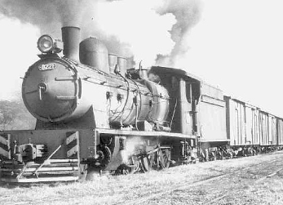
Economy
Political unrest and civil war prior to Diaz→ lack of respect in international community
By 1888: Treaties of friendship, commerce, and navigation with Sweden, Norway, France, UK, Ecuador, America, and Japan
Brought much needed capital
US offered almost unlimited market for Mexican goods
Improving infrastructure→ Railroad construction
Laws favorable to foreign investment and mines
Restrictive colonial tax on commerce was abolished→ free trade
Abolished communal land system in favor of private enterprise approach
UNEVEN DISTRIBUTION OF WEALTH

Slide 5
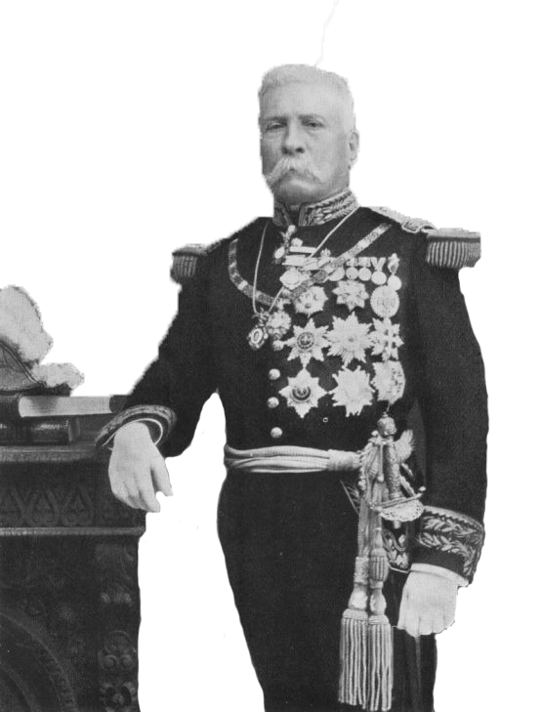
Porfirio Diaz
Born into a poor peasant family and rose through the ranks of the military→ War Hero
Put in office in 1876
Pragmatist
Didn’t trust anyone→ made fear a cornerstone of his regime
“Divide and Conquer”→ make associates suspicious of each other

Slide 6
Ideology/Politics
Stability and growth
“Order” and “Progress”
Implementation of law and order
Economic growth and attraction of foreign investment over well being of the people
Diplomatic relations

Slide 7
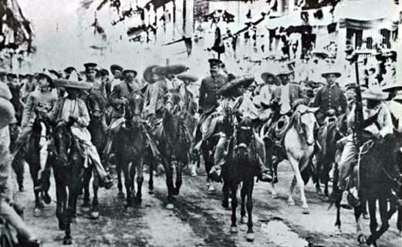
How did it change?
Elections
Francisco Madero had gathered much popular support
Diaz was proclaimed to have been re-elected unanimously
Electoral fraud
Madero called for revolt against Diaz→ Mexican Revolution
Diaz forced from office and fled the country

Slide 8
References
http://www.dartmouth.edu/~izapa/LFS_Chapter%208%20.htm
https://journal.lib.uoguelph.ca/index.php/surg/article/view/1776/2415
http://countrystudies.us/mexico/23.htm
http://mexicanhistory.org/Diaz.htm

